Slide 1
Welcome to Marketing Management
Dr. Cecilia Ruvalcaba
BUSI 107 Week 2, Day 2

Slide 2
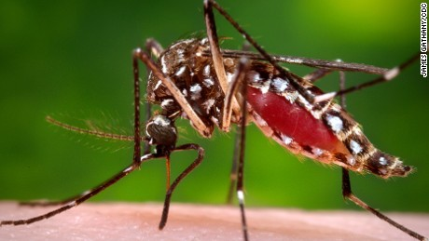
Zika virus likely to spread throughout the Americas, says WHO
Notes:
Zika virus likely to spread throughout the Americas, says WHO
http://www.theguardian.com/world/2016/jan/25/zika-virus-likely-spread-throughout-americas-says-who

Slide 3
Chapter 2: developing Marketing Strategies

Slide 4
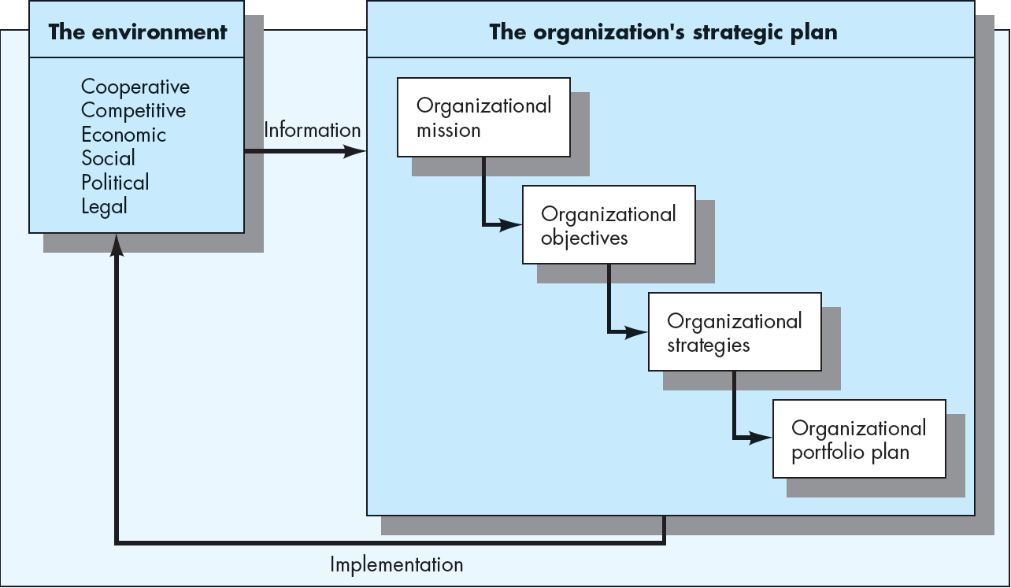
The Strategic Planning Process
Focus
Goals
Culture
Technology
Industry
Direction

Slide 5
The marketing management process
Business Mission Statement
Process of planning and executing the conception, pricing, promotion, and distribution of goods, services, and ideas to create exchanges with target groups that satisfy customer and organizational objectives
Objectives
Situation Analysis
& SWOT
Marketing Strategy
Target Market Strategy
Marketing Mix
Product
Distribution
Promotion
Price
Implementation Evaluation Control

Slide 6
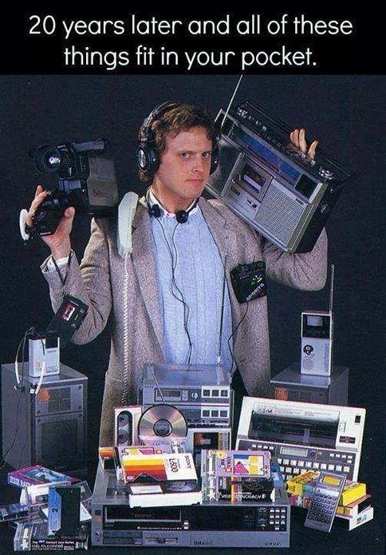
Situation Analysis & SWOT
Analysis of past, present and future factors relevant to the marketing opportunity.
Strengths & Weaknesses (Internal)
Opportunities & Threats (External)
Industry Analysis (an overview)
Trends, Key Issues, Challenges Facing the
Whole Industry
The Cooperative Environment
The Competitive Environment
The Economic Environment
The Social/Cultural Environment
The Political Environment
The Legal Environment
The Technological Environment

Slide 7
SWOT Analysis (situated)
S
Things the company does well.
Internal
W
Things the company does not do well.
O
Conditions in the external environment that favor strengths.
External
T
Conditions in the external environment that do not relate to existing strengths or favor areas of current weakness.
©South-Western College Publishing

Slide 8
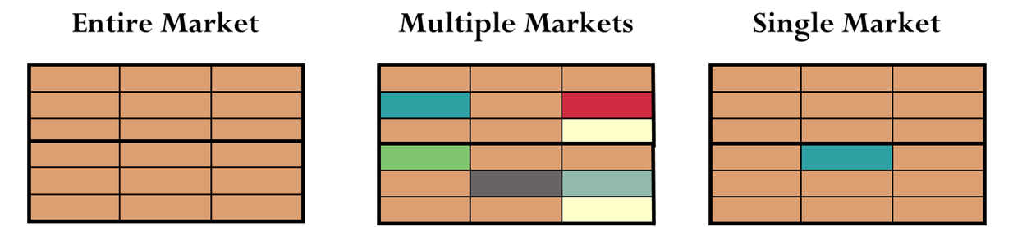
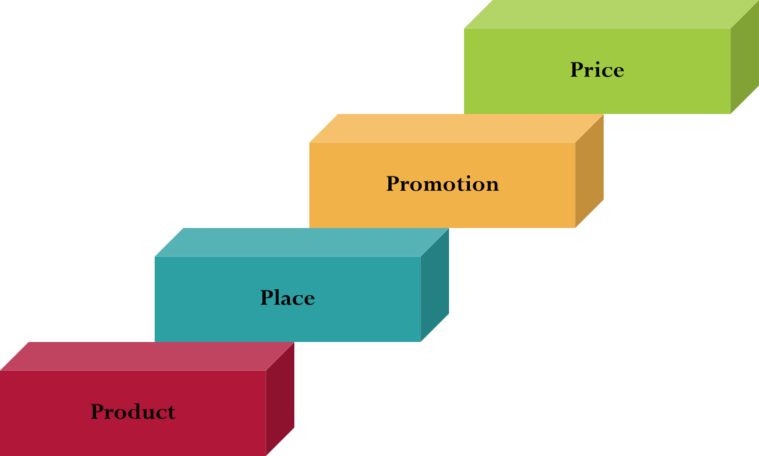
Marketing Strategy
Selecting the Target Market
Developing the Marketing Mix
Implementation, Evaluation & Control

Slide 9


Take Away for Today
You need a plan!
Pre-Planning for Success
(Focus, Goals, Direction)
SWOT for any strategy!

Slide 10

Next Class
Chapter 10: Marketing Research
Submit Groups

